Slide 1
StellarSnap
Visual discovery engine for finding ideas, people, trends, home, style inspiration, and more
PixelTriads/Team number: 3
Pearl (Team Leader) 2210990648
Prachi Anand 2210990660
Prachi Malik 2210990661

Slide 2
Index
Objective
Introduction
Methodology, Approach & Techniques
Algorithm
Flow Chart
Result
Source Code (Screenshots)
Conclusion
Reference

Slide 3
Objective
The objective of StellarSnap, the website created using HTML, CSS, and JavaScript, could be multi-faceted, aiming to accomplish several goals:
1. Provide Visual Bookmarking Service: StellarSnap should allow users to visually bookmark content from around the web. The primary objective is to create a platform where users can discover, save, and organize images and ideas that interest them.
2. User Engagement: Encourage users to engage actively with the platform by saving, sharing, and commenting on pins. Increasing user interaction contributes to the growth and sustainability of the platform.

Slide 4
Objective
3. Personalization and Curation: Enable users to personalize their experience by curating boards and following other users with similar interests. This fosters a sense of community and helps users discover content relevant to their tastes.
4. Monetization: Depending on the business model, the objective could include generating revenue through advertising, sponsored content, or premium features. Monetization strategies should be implemented without compromising user experience.
By aligning its objectives with these principles, StellarSnap can strive to become a successful Pinterest clone while offering its unique value proposition to users.

Slide 5
Introduction
StellarSnap is a visual discovery engine for finding ideas like recipes, home and style inspiration, and more. With billions of Pins on StellarSnap, you'll always find ideas to spark inspiration. When you discover Pins you love, save them to boards to keep your ideas organized and easy to find. You can also create Pins to share your ideas with other people on StellarSnap.
Your home feed is where you'll find Pins, people and businesses we think you'll love, based on your recent activity. We'll also show you Pins from the people and boards you choose to follow.
You can also search for Pins by typing in keywords into the search bar. Try typing "birthday party" in the search bar to see ideas for birthday party decor, party food recipes, and birthday gift ideas.

Slide 6
Introduction
Use the search bar to discover ideas, people, and trends. Explore suggested topics or search for topics of your own. Tap Profiles on the search page to discover creators, people, and brands based on your search. Use your camera to find ideas relevant to your photos and narrow beauty results by skin tone range or hair pattern.

Slide 7
Methodology, Approach and Techniques
Methodology and Approach:
1. Requirement Analysis: Understand the objectives and target audience of StellarSnap.
2. Design and Planning: Create wireframes and plan the architecture and features of the platform.
3. Technology Selection: Choose appropriate technologies for frontend and backend development.
4. Agile Development: Use an iterative approach to build and refine the platform.
5. Testing and Quality Assurance: Ensure functionality, usability, and performance through rigorous testing.

Slide 8
6. Deployment and Launch: Deploy the platform to production and execute a marketing strategy.
7. User Feedback and Iteration: Gather user feedback and iterate based on usage metrics and behavior.
8. Maintenance and Support: Provide ongoing maintenance and updates to keep the platform stable and secure.

Slide 9
Techniques:
Various techniques used to build StellarSnap are:
1. HTML, or Hypertext Markup Language, is the standard markup language used to create and structure content on web pages. It serves as the foundation of the World Wide Web and is essential for building websites and web applications.
HTML consists of a series of elements or tags that define the structure and semantics of a web page. These elements include headings, paragraphs, lists, links, images, forms, tables, and more. Each element is enclosed within opening and closing tags and may contain attributes that provide additional information or modify the element's behavior.

Slide 10
2. CSS, or Cascading Style Sheets, is a style sheet language used to describe the presentation and visual formatting of HTML and XML documents. It enables web developers to control the appearance of web pages, including layout, colors, fonts, spacing, and more.
CSS works by associating style rules with HTML elements, specifying how those elements should be displayed in the browser.
3. JavaScript is a high-level, interpreted programming language primarily used for building dynamic and interactive web applications. It is one of the core technologies of web development, alongside HTML (Hypertext Markup Language) and CSS (Cascading Style Sheets). JavaScript allows developers to add interactivity, manipulate the content of web pages, respond to user actions, and dynamically update the page without requiring a full page reload.

Slide 11
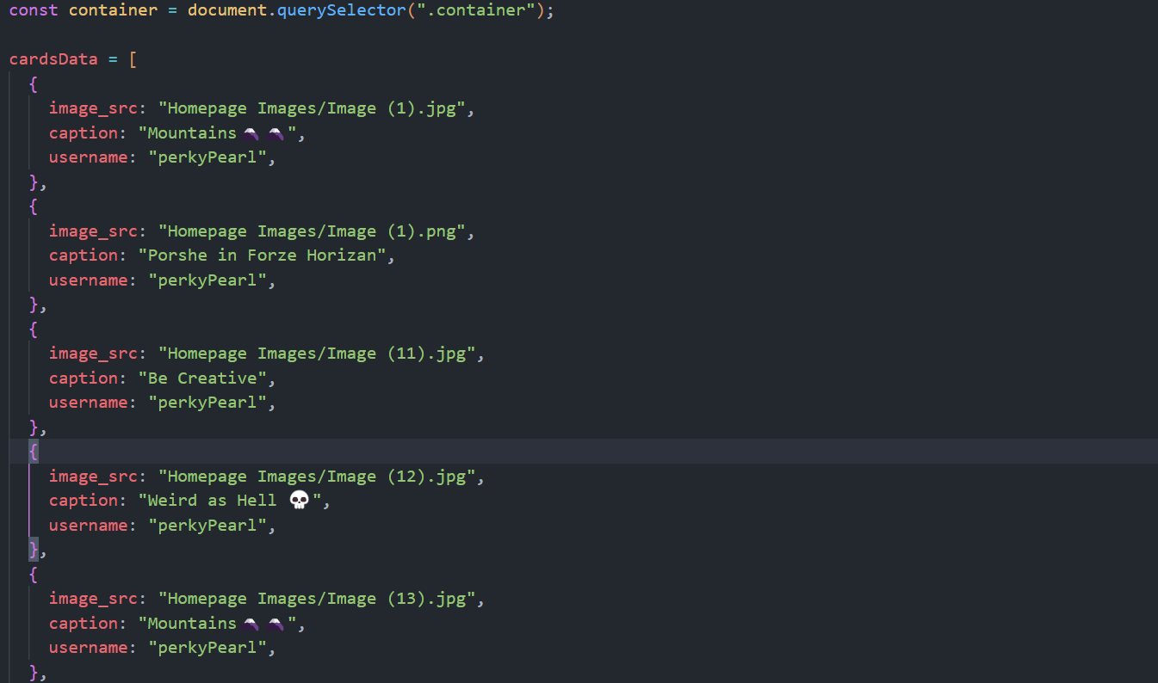
Algorithm
Data Compilation: Gather the Information and Store that into the form of arrays of JSON(JavaScript Object Notation) with the Source of the Images, Caption and Username of the Person who posted it.
Fig (1). Snapshot Of Data Compilation

Slide 12
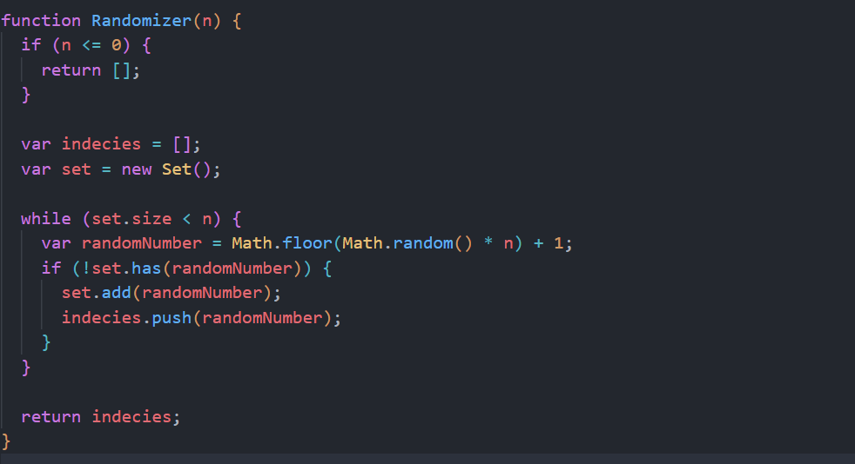
Algorithm
Randomizer: It Creates an array of the size of the data to be displayed on the Feed. It creates a random unique elements array and stores that into an array
Fig (2). Snapshot Of Randomizer

Slide 13
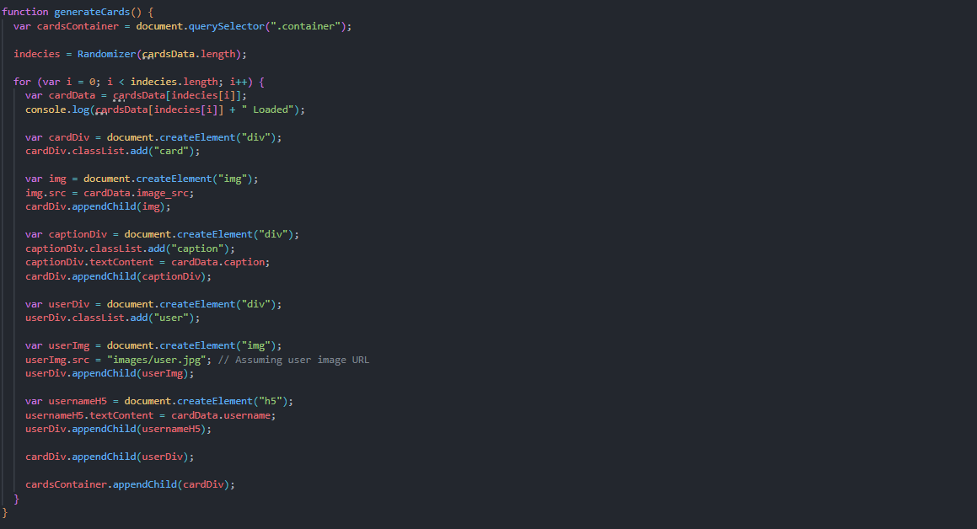
Algorithm
Generating Cards: This creates the Cards on the Webpage using DOM (Document Object Model) Manipulation. It access the Data from the Database in this case, Array of JSON and access their Images Sources, Caption and User who sent that. And Renders it.
Fig (3). Snapshot Of Generating Cards

Slide 14
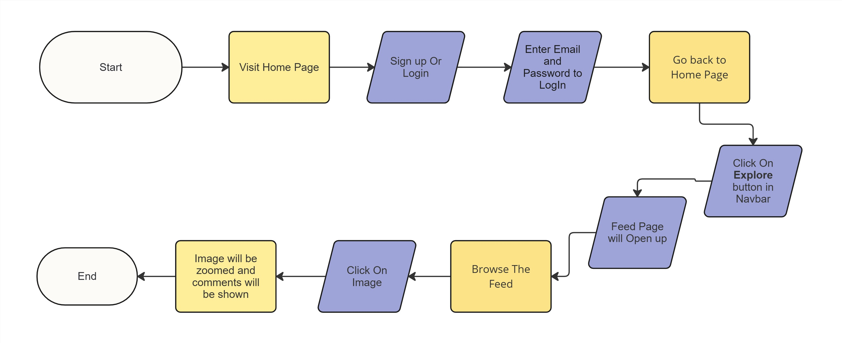
Flowchart

Slide 15
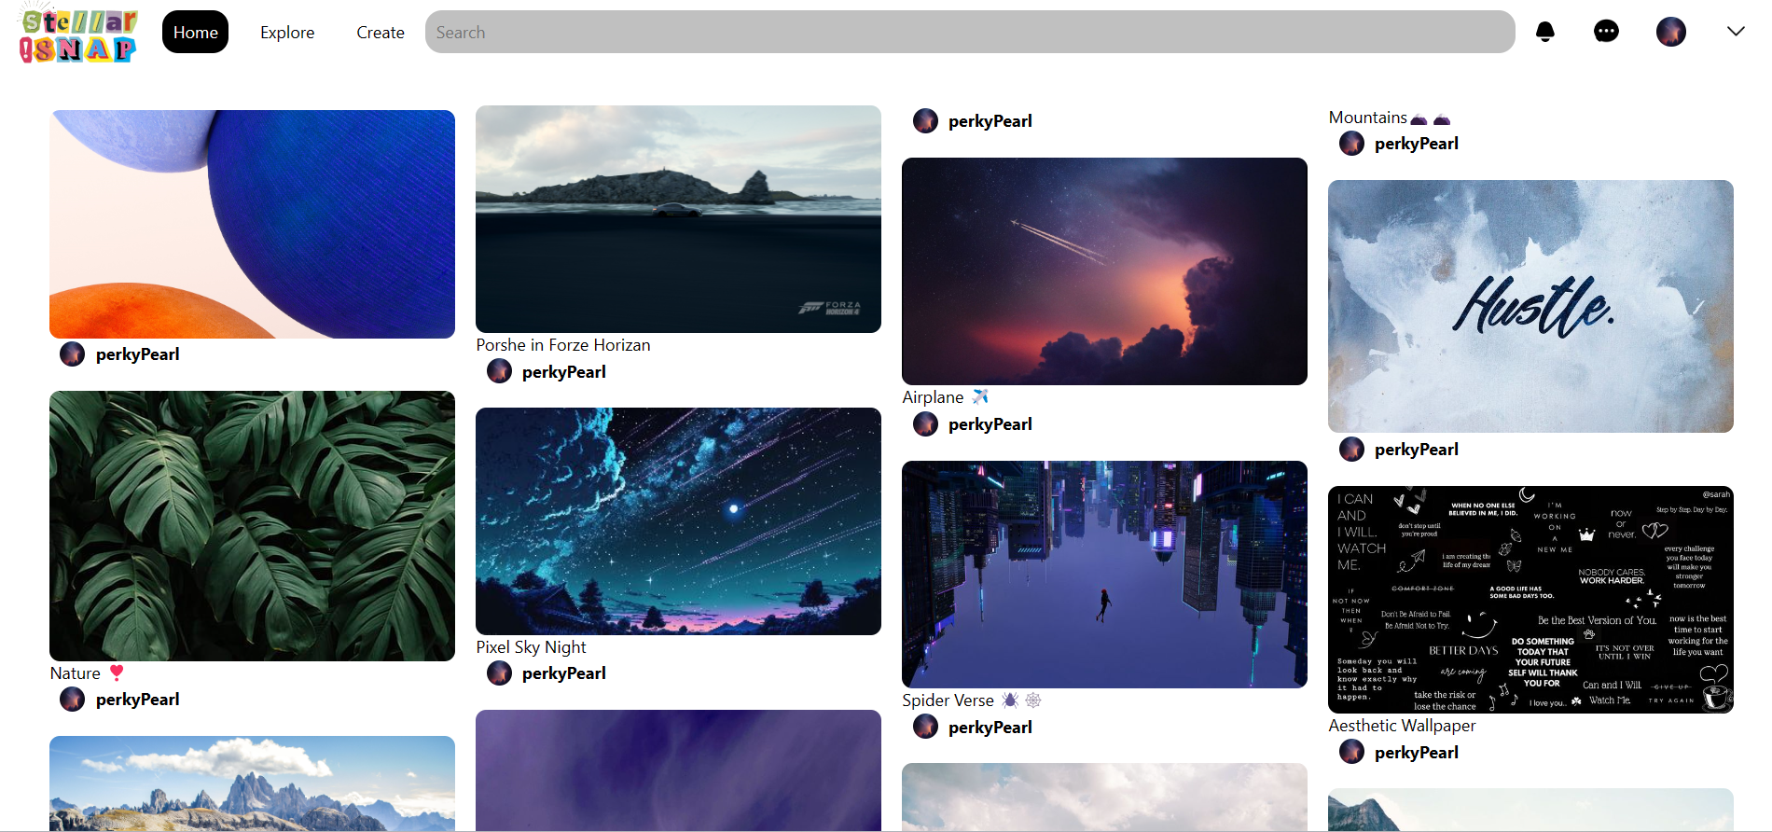
Result
Feed of the Website:
Fig (4). Result Feed Of Website

Slide 16
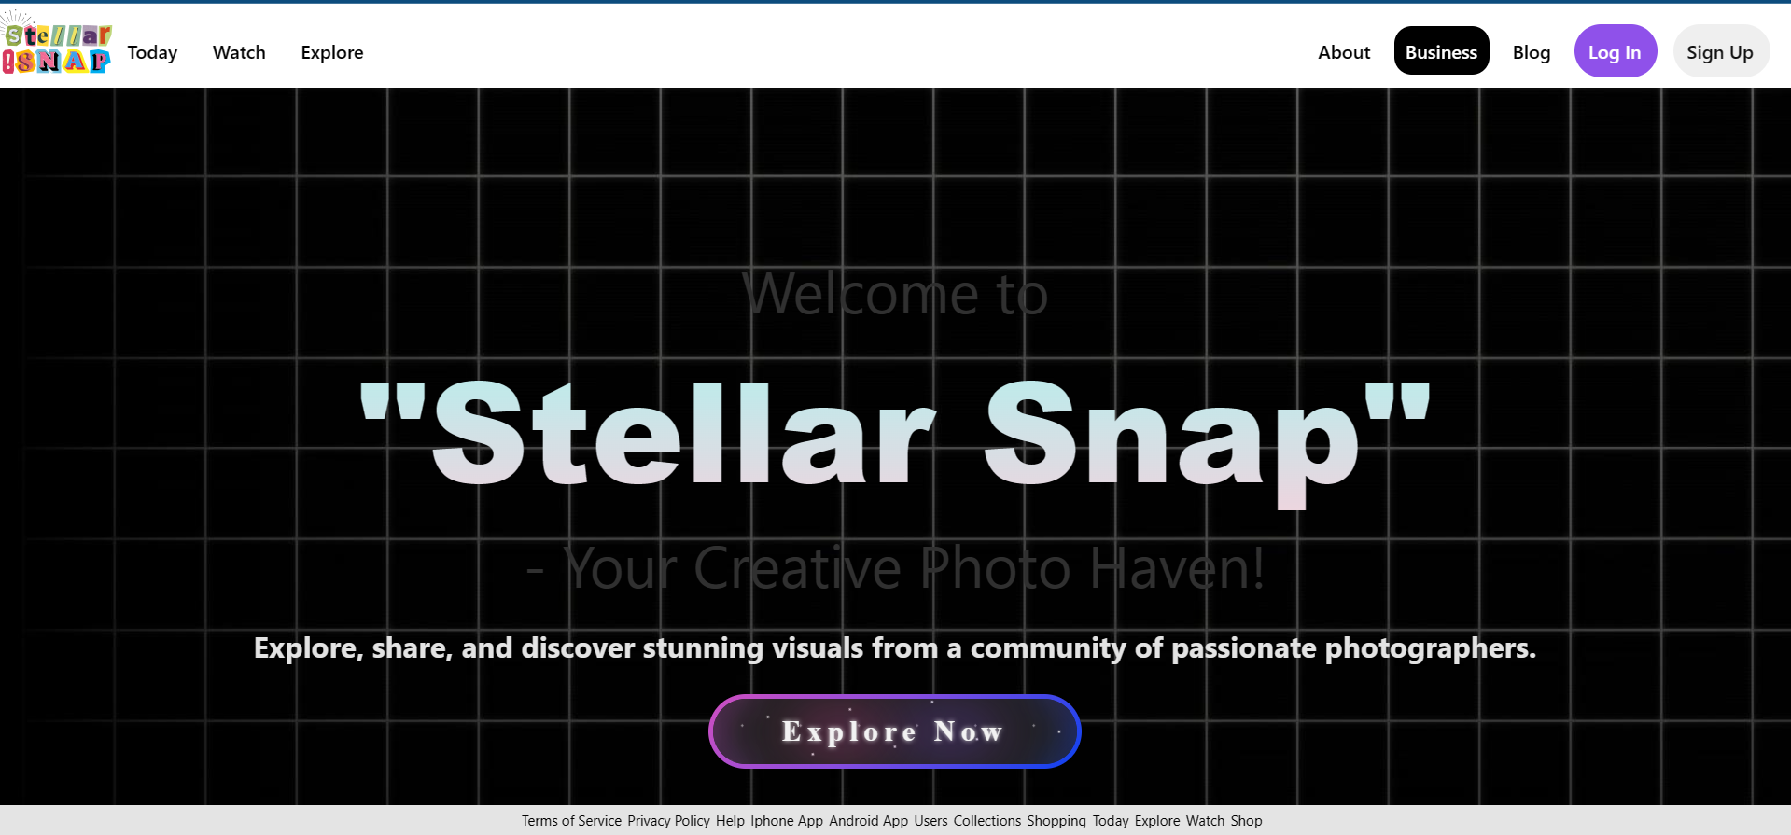
Result
Fig (4). Screenshot Of Home Page

Slide 17
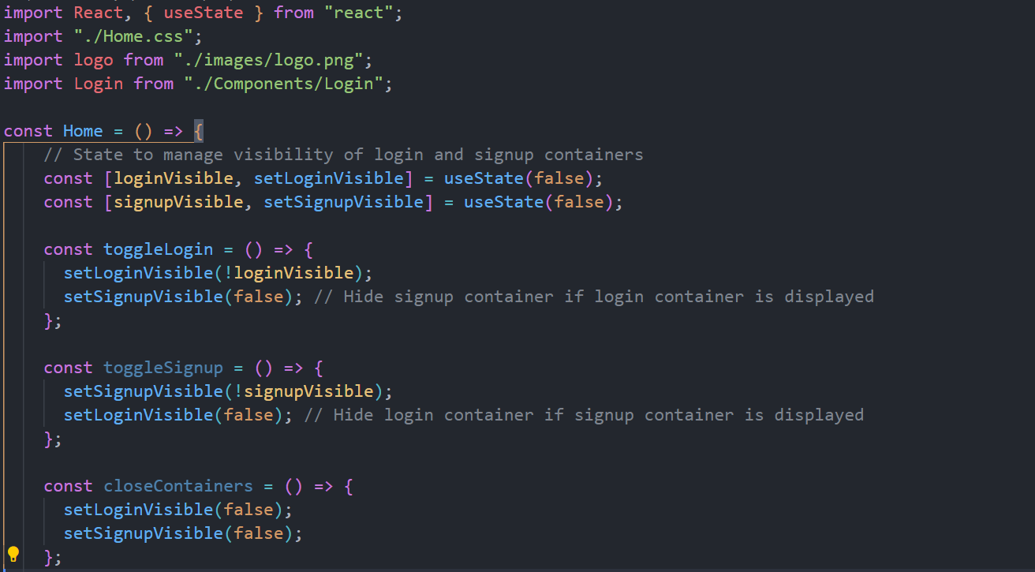
Home.jsx
Fig (5). Screenshot Of Home.jsx

Slide 18
Explanation Of Home.jsx
This code defines a React functional component named Home, which represents the homepage of a web application.
It imports React and useState hook from the 'react' library, enabling state management within the component.
State variables loginVisible and signupVisible are initialized using the useState hook to manage the visibility of login and signup containers.
Functions toggleLogin, toggleSignup, and closeContainers are defined to toggle the visibility of login and signup containers based on user interactions.
The component renders JSX elements representing the webpage’s structure, including the header, sections, and footer.
The header contains a logo and navigation options, while sections present informational content about the application, trending photos, diverse collections, and community engagement.
Conditional rendering is used to display a login form when the loginVisible state is true.
The footer includes links to various pages and sections of the website.
Overall, this component orchestrates the layout and behavior of the homepage, providing users with navigation options, informational content, and interaction capabilities such as logging in.

Slide 19
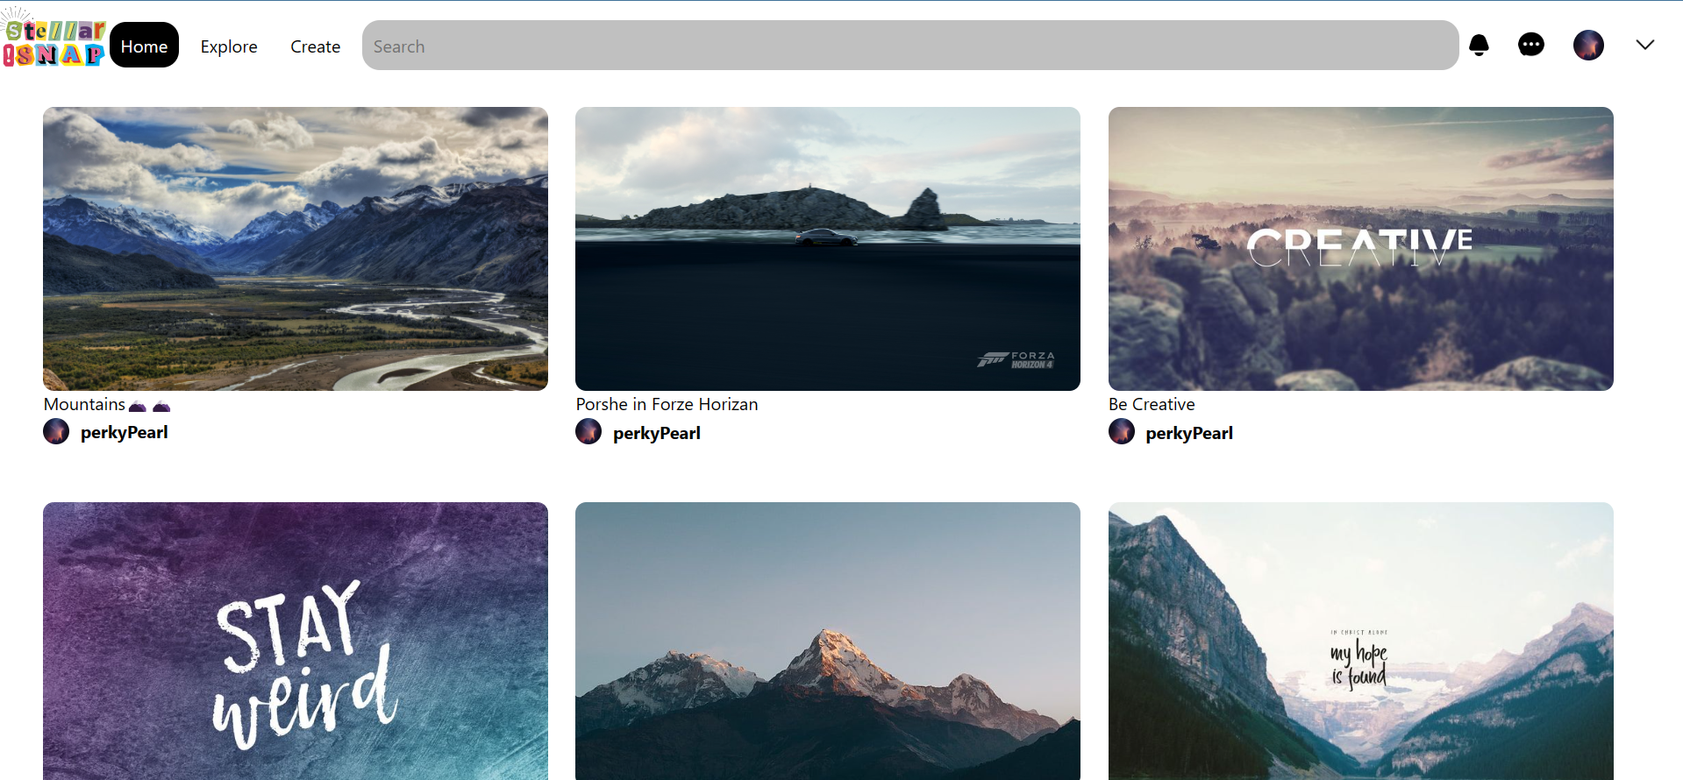
Result
Fig (6). Screenshot Of Feed Page

Slide 20
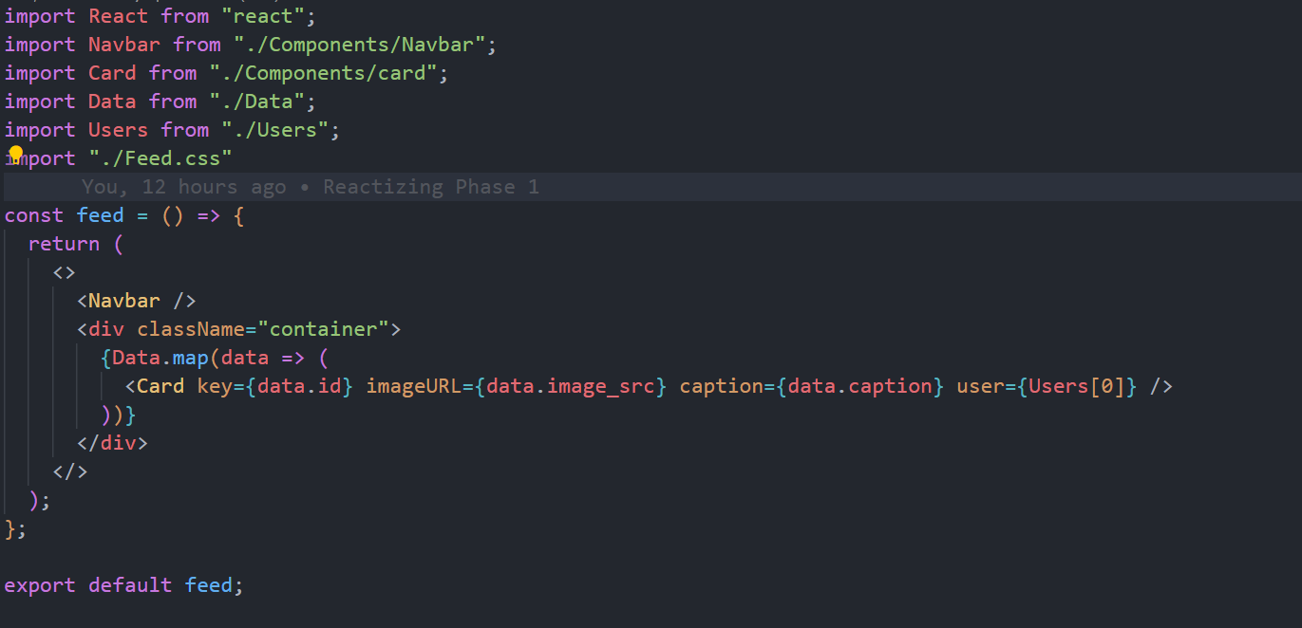
Feed.jsx
Fig (7). Screenshot Of Feed.jsx

Slide 21
Explanation Of Feed.jsx
The code defines a React functional component named `feed`, representing a feed page in a web application.
It imports React and other necessary components and data sources from various files.
The `Navbar` component is imported to include a navigation bar at the top of the feed page.
A container div with the className "container" is defined to hold the content of the feed page.
The `Data` array, containing information about various posts, is imported from "./Data".
The `Users` array, containing user information, is imported from "./Users".
Inside the container div, a loop iterates over each item in the `Data` array using the `map` function.
For each item in the `Data` array, a `Card` component is rendered with properties such as `key`, `imageURL`, `caption`, and `user`.
The `key` property is set to the unique identifier of each post to ensure efficient rendering and updates.
The `imageURL` and `caption` properties are passed to the `Card` component to display the image and caption of each post.
The `user` property is set to the first user in the `Users` array, indicating the author of each post.
Overall, this component structures the feed page by including a navigation bar and rendering a series of cards representing individual posts fetched from the `Data` array.

Slide 22
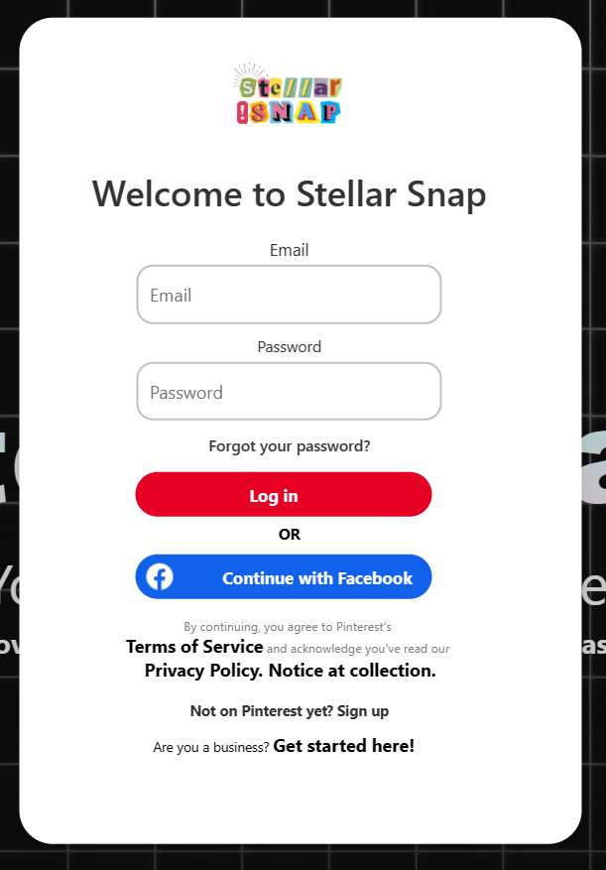
Result
Fig (8). Screenshot Of Login Overlay

Slide 23
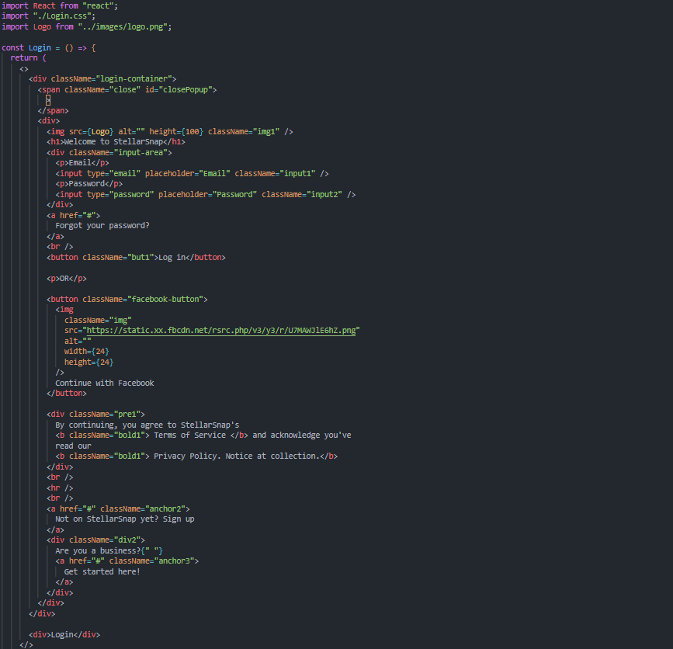
Login.jsx
Fig (9). Screenshot Of Login.jsx

Slide 24
Explanation Of Login.jsx
The code defines a React functional component named `Login`, which represents a login form in a web application.
It imports React and includes CSS styles from "./Login.css" to style the login form.
The login form contains an image of the application's logo, the heading "Welcome to StellarSnap", and input fields for email and password.
An anchor tag is provided for users who forgot their password, allowing them to reset it.
A "Log in" button is provided for users to submit their login credentials and authenticate.
Alternatively, users can log in using their Facebook account by clicking the "Continue with Facebook" button.
A disclaimer message informs users that by logging in, they agree to the application's terms of service and privacy policy.
Links are included for users who are not yet registered on StellarSnap to sign up, as well as for businesses to get started with the platform.
The `toggle` function is passed as a prop to handle closing the login form when the "×" close button is clicked.
Overall, this component provides a user-friendly interface for logging into the StellarSnap application, including options for password recovery, social login, and registration.

Slide 25

Result
Fig (10). Screenshot Of Navbar

Slide 26
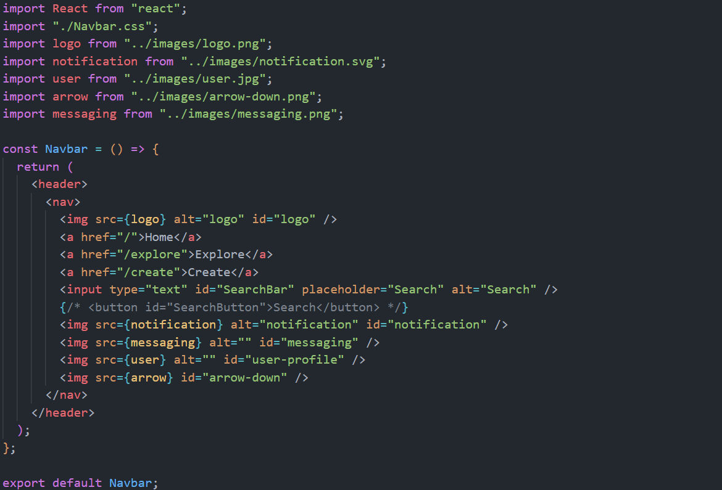
Navbar.jsx
Fig (11). Screenshot Of Navbar.jsx

Slide 27
Explanation Of Navbar.jsx
The code defines a React functional component named `Navbar`, representing the navigation bar of a web application.
It imports React and includes CSS styles from "./Navbar.css" to style the navigation bar.
The navigation bar contains a logo image of the application, followed by links for the "Home", "Explore", and "Create" pages.
An input field with the ID "SearchBar" is provided for users to search for content within the application.
Icons for notification, messaging, and user profiles are displayed using image tags with respective image sources.
An arrow-down icon is displayed using an image tag, suggesting additional options or dropdown functionality.
Each image source is imported from the "../images" directory, including the logo, notification, user profile, arrow-down icon, and messaging icon.
The navigation bar provides essential functionality for users to navigate between different pages of the application, search for content, and access user-specific features such as notifications and messaging.
Overall, this component enhances the user experience by offering easy access to key functionalities and navigation options within the application.

Slide 28
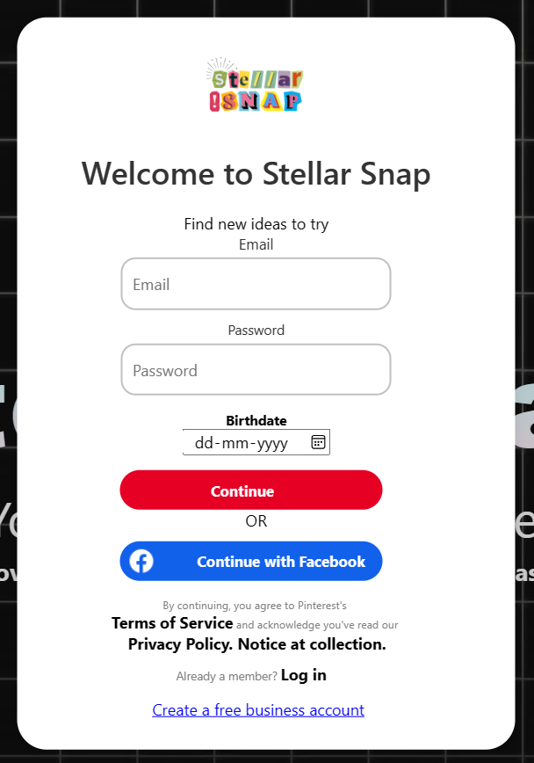
Result
Fig (12). Screenshot Of Sign Up Overlay

Slide 29
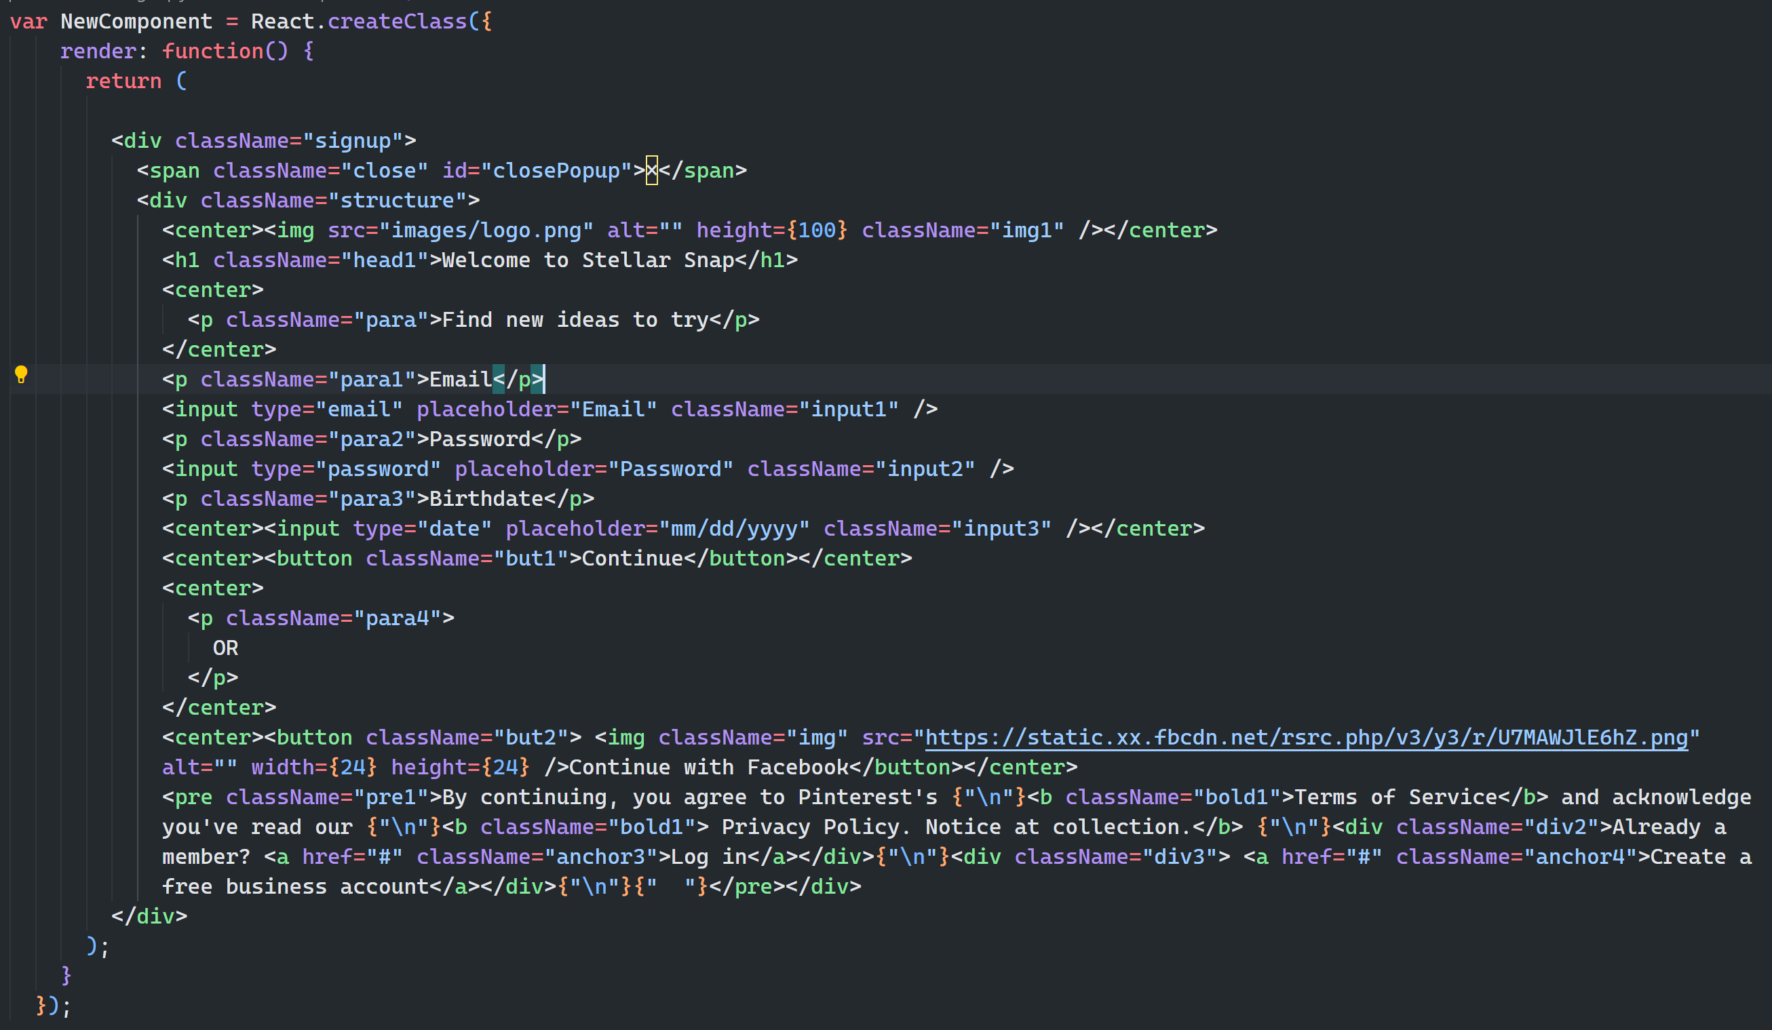
SignUp.jsx
Fig (13). Screenshot Of SignUp.jsx

Slide 30
Explanation Of SignUp.jsx
The code defines a React component named `NewComponent` using the `React.createClass` method, which is an older way of creating React components. This method has been deprecated in favor of class components or functional components with hooks.
The `render` method is provided within the component, responsible for returning the JSX (JavaScript XML) markup to be rendered on the screen.
JSX elements representing a signup form are defined within the `render` method, including headings, input fields for email and password, a button to continue, and options to sign up with Facebook or create a business account.
CSS classes are applied to various elements to style them according to the application's design.
Images are included using `<img>` tags, with source URLs pointing to image files located in the "images" directory.
The signup form collects user information such as email, password, and birthdate, with options for authentication via Facebook or creating a business account.
A disclaimer message is provided, informing users about the application's terms of service and privacy policy, along with options to log in or create a business account.
Overall, this component represents a signup form for users to register with the Stellar Snap application, providing essential functionality and user interface elements for the signup process.

Slide 31
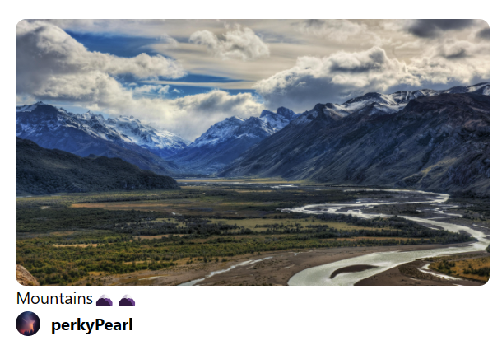
Result
Fig (14). Screenshot Of Card Component

Slide 32
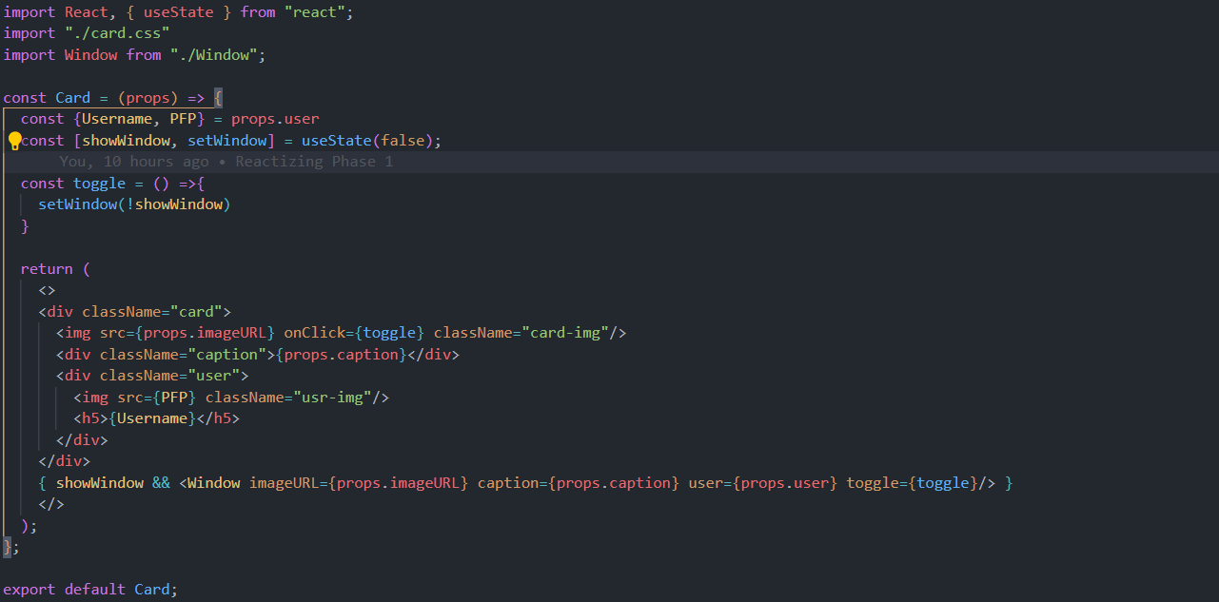
Card.jsx
Fig (15). Screenshot Of Card.jsx

Slide 33
Explanation Of Card.jsx
The code defines a React functional component named `Card`, representing a card component to display content such as images and captions.
It imports React and useState hook from "react" and includes CSS styles from "./card.css" to style the card component.
Props such as `imageURL`, `caption`, and `user` are passed to the component to customize its content.
The `useState` hook is used to manage the state variable `showWindow`, which controls the visibility of a window component associated with the card.
The `toggle` function toggles the value of `showWindow`, changing the visibility of the window component.
JSX elements representing the card's structure are defined, including an image, caption, and user information.
When the image is clicked, the `toggle` function is invoked, toggling the visibility of the window component.
Conditional rendering is used to conditionally display the window component based on the value of `showWindow`.
The window component is rendered with props such as `imageURL`, `caption`, and `user` when `showWindow` is true.
Overall, this component represents a card that displays content and allows users to interact with additional information displayed in a window component.

Slide 34
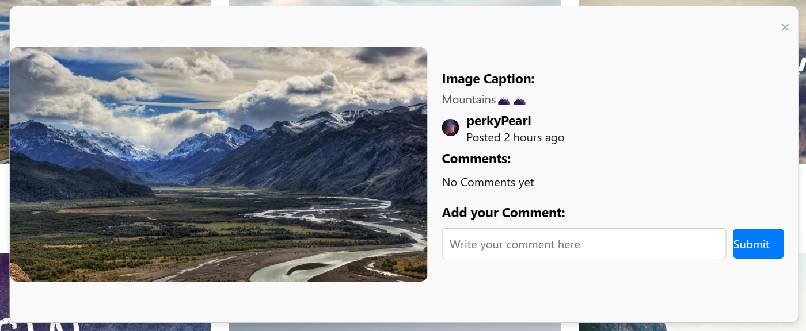
Result
Fig (16). Screenshot Of Window Component

Slide 35
Window.jsx
Fig (17). Screenshot Of Window.jsx

Slide 36
Explanation Of Window.jsx
The code defines a React functional component named `Window`, which represents a window overlay that displays detailed information about a specific image or content.
This component receives props such as `imageURL`, `caption`, and `user` to customize its content dynamically based on the specific image or content being displayed.
The window contains a close button (`&times;`) that triggers the `toggle` function when clicked, allowing users to close the window overlay.
Within the window content, the component displays the image using an `<img>` tag with the `src` attribute set to the `imageURL` prop.
It also displays the image caption, username, and the time since the image was posted. This information is provided through props such as `caption` and `user`.
Additionally, a comments section is included, showing placeholders for comments and providing an input field for users to add their comments.
The component structure follows a clean and organized layout using CSS classes like `window`, `window-content`, `image-container`, `user`, `comments-area`, etc., to style the elements appropriately.
Overall, the `Window` component serves as a reusable and customizable overlay for displaying detailed content associated with images or other types of media.

Slide 37
Conclusion
In conclusion, StellarSnap presents itself as a promising contender in the realm of social media platforms, offering users a visually appealing and intuitive interface akin to Pinterest. Through its innovative features, seamless user experience, and robust community engagement tools, StellarSnap has the potential to carve out its own niche in the market. As we've explored throughout this analysis, its emphasis on creativity, inspiration, and seamless content discovery sets it apart, catering to a diverse range of interests and passions. Moving forward, continued focus on user feedback, technological advancements, and strategic partnerships will be pivotal in sustaining StellarSnap's growth trajectory and solidifying its position as a leading destination for visual discovery and inspiration on the web.

Slide 38
Reference
Pinterest, https://in.pinterest.com/,Accessed on March 3, 2024
ChatGPT, chat.openai.com, Accesed on March 1,2024
Google, https://www.google.com, Accesed on February 25,2024

Slide 39
Thank You!!

